Slide 1
Analysis of Variance or test of ANOVA

Slide 2
The F test, used to compare two variances can also be used to compare three of more means.
This technique is called analysis of variance, or ANOVA.
It is used to test claims involving three or more means.
For there groups, the F test can only show whether a difference exists among the three means. It cannot reveal where the difference lies – that is, between ${\overline{X}}_{1}$ and ${\overline{X}}_{2}$ or ${\overline{X}}_{1}$and ${\overline{X}}_{3}$, or ${\overline{X}}_{2}$ and ${\overline{X}}_{3}$.
If the F test indicates that there is a difference among the means, other statistical tests are used to find where the difference exists.
The most commonly used tests are the Scheffé test and Tukey test.

Slide 3
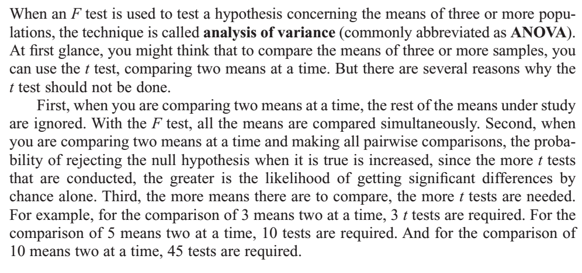

Slide 5
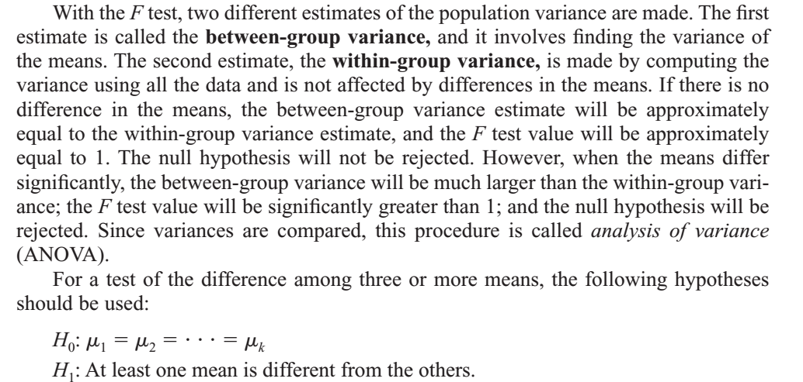

Slide 7
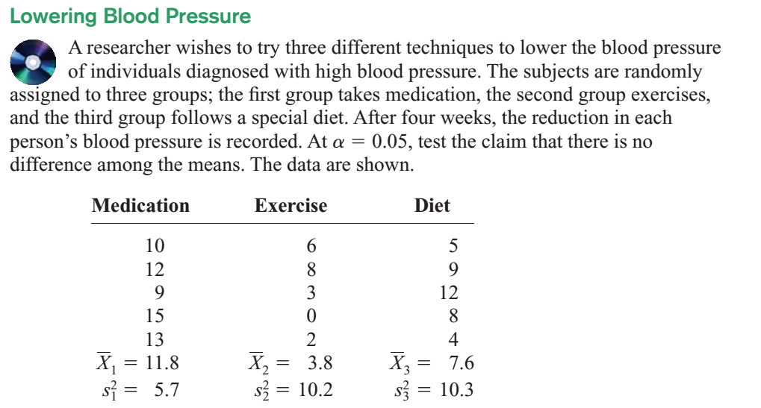

Slide 8
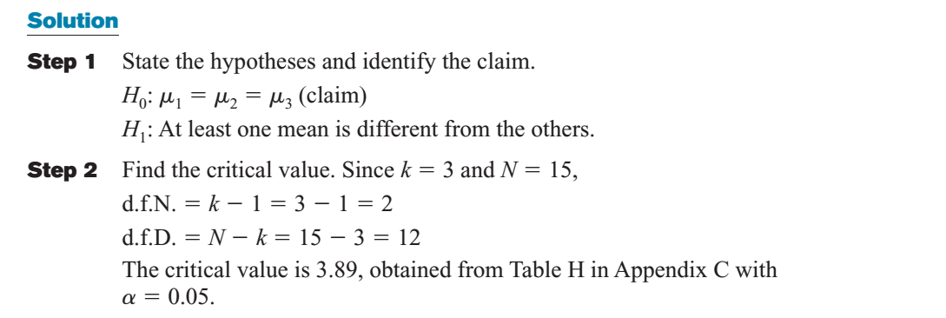

Slide 9
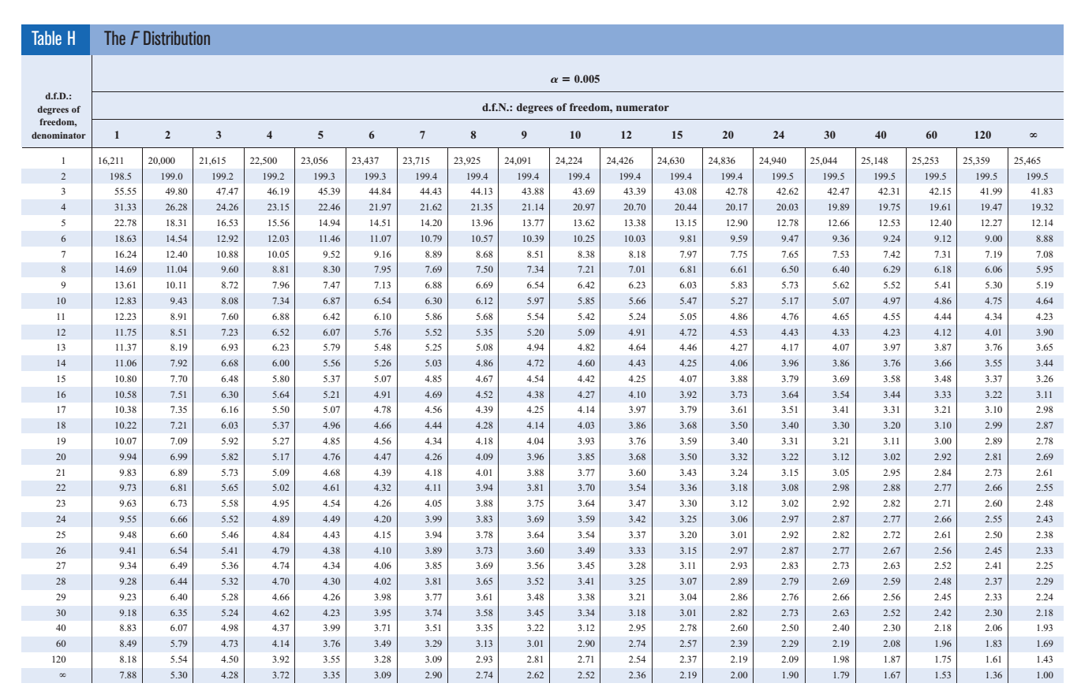

Slide 10
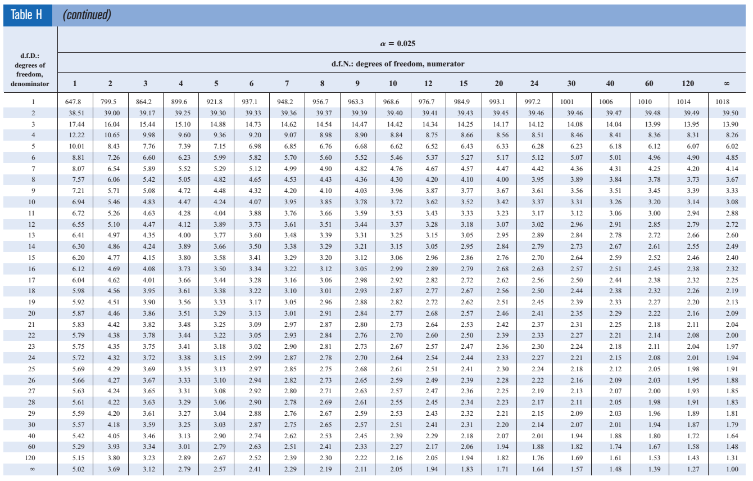

Slide 11
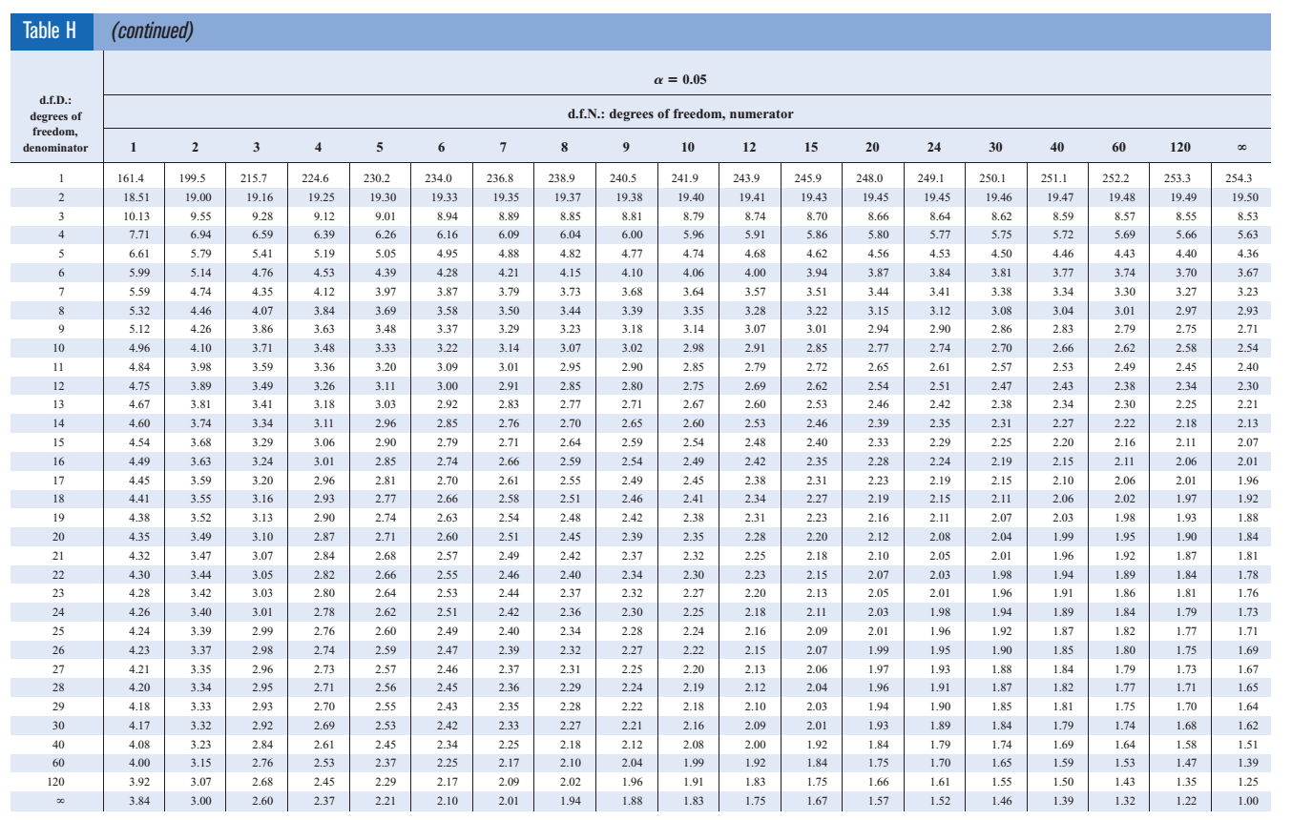

Slide 12
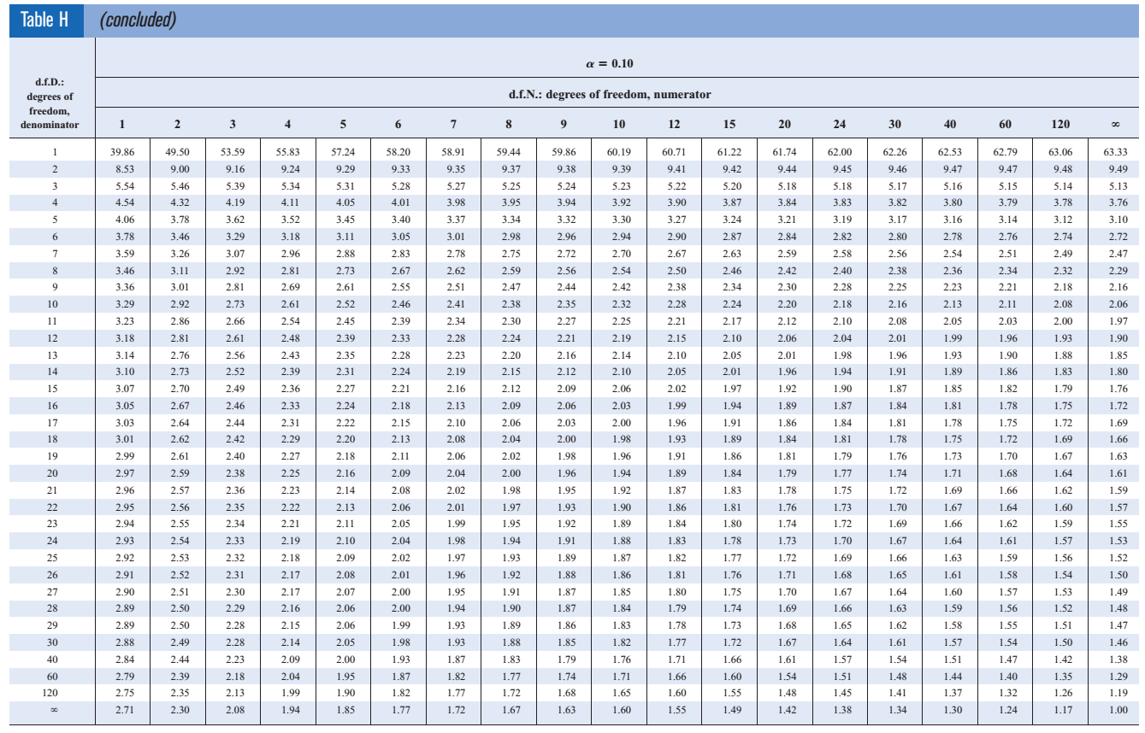

Slide 13
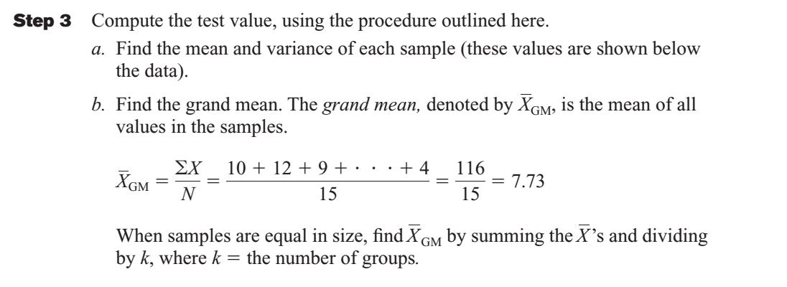

Slide 18
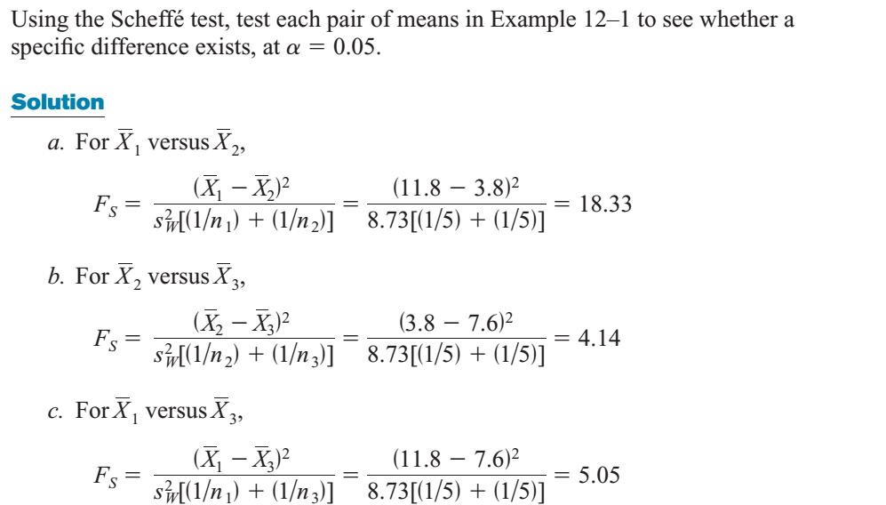

Slide 21
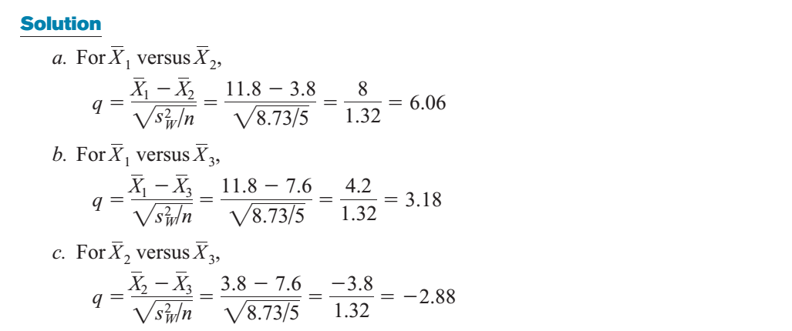

Slide 23
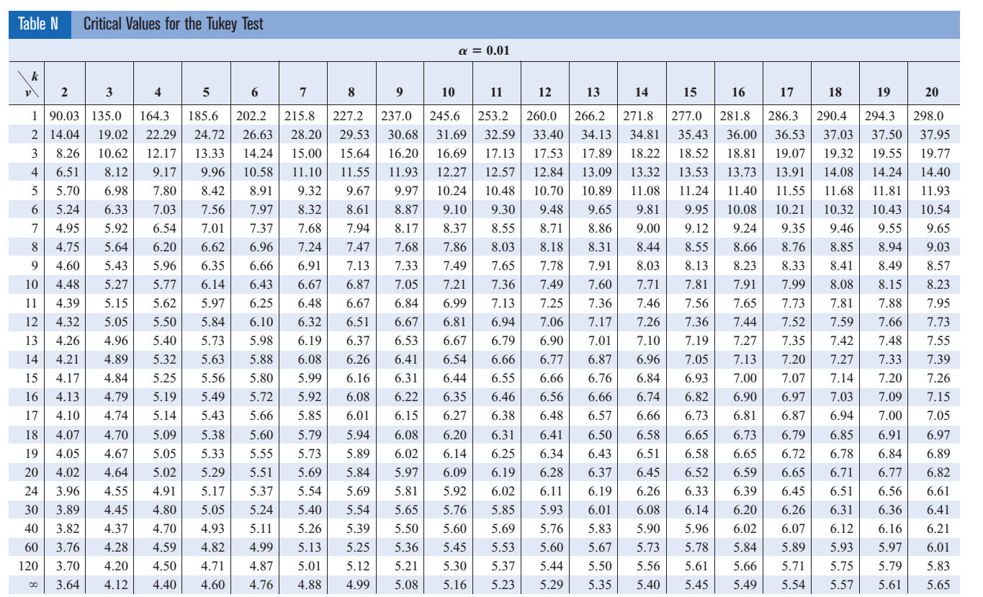

Slide 24
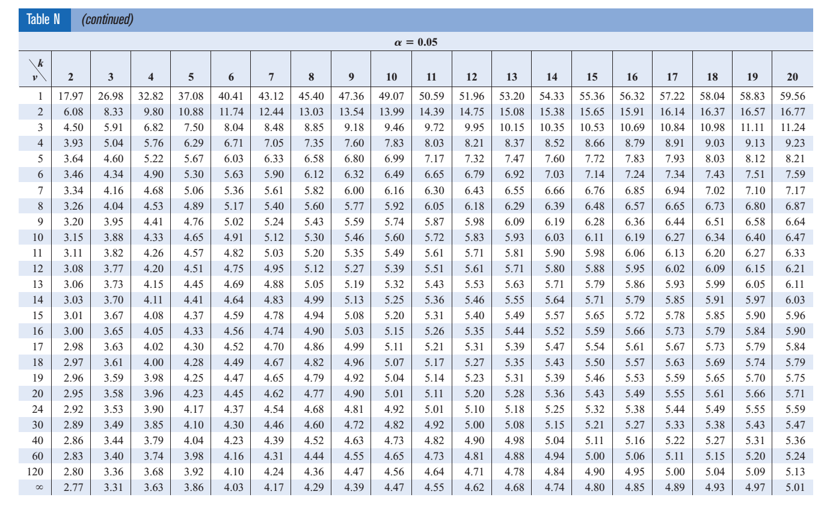

Slide 25
